Slide 1
AI/ML Loss Function
Lecture II
Alexei Prokudin
PHYS496

Slide 2
LOSS FUNCTION
The loss function is the mathematical way of telling an AI what to learn. Wrong loss function can have catastrophic outcomes
Purpose of the Loss Function:
The loss function quantifies the difference between the model's predictions and the actual values (ground truth).
During training, the model tries to minimize this difference by adjusting its internal parameters (weights and biases).
It provides a numerical value (loss) that the optimization algorithm (e.g., gradient descent) uses to update the model’s parameters.

Slide 3
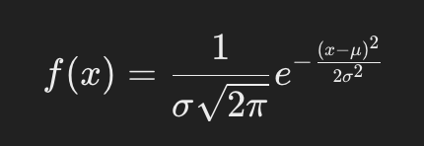

EXPERIMENTAL DATA
What is the experimental data?
Result of a measurement:
Multiple measurements form a histogram that generally has a bell shape.
From the histogram one extracts the mean value and the standard deviation.
The bell-shaped curve is normalized such the integral over all values is 1, that corresponds to 100% probability to measure something in the interval of the $value$in $(−∞,+∞)$

Slide 4
EXPERIMENTAL DATA
Suppose that now we have N measurements that depend on some variable

Slide 5
EXPERIMENTAL DATA AND THEORY
We have some theory that describes the data and depends on some parameters “a” which we would like to determine from the data
We can compare the theory to the data. Is the description good or bad? How can we judge?

Slide 6


CHI-SQUARE $χ^{2}$
To determine the goodness of description, the following is computed:
One expects $\frac{χ^{2}}{N}∼1$ for normally distributed experimental data.
If the result is either >> 1, or << 1, the description is bad.

Slide 7
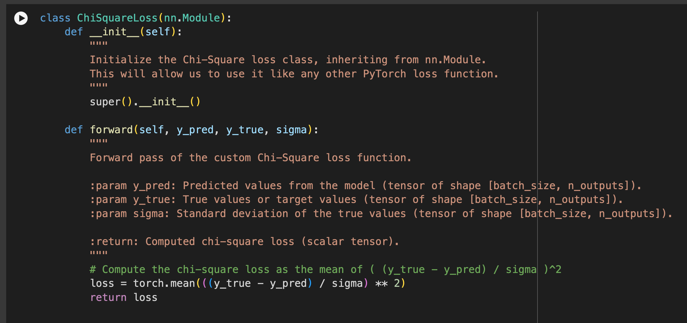

CHI-SQUARE $χ^{2}$
The following is a PyTorch class based on nn.Module that computes $χ^{2}$
https://github.com/prokudin/PHYS496-Fall2024/blob/main/Tutorials/PHYS496_Fall_2024_(4)_PyTorch_Nonlinear_Regression_with_NN_improved.ipynb

